Slide 1

TECHNIQUES OF INTEGRATION

Slide 2
OBJECTIVES
At the end of the lesson, the student should be able to:
find an antiderivative using integration by parts.
use trigonometric substitution to solve an integral.
use algebraic substitution to solve an integral.
use reciprocal substitution to solve an integral.
evaluate an indefinite integral involving rational functions of sine and cosine.
use partial decomposition with linear factors and quadratic factors to integrate rational functions.

Slide 3
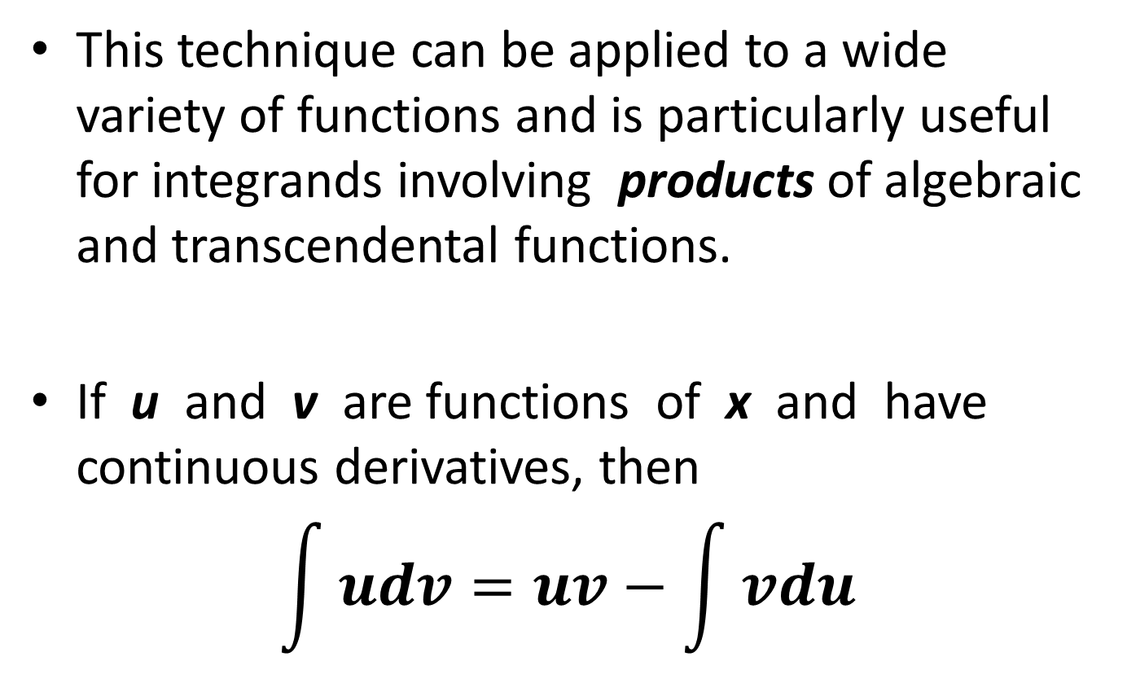
INTEGRATION BY PARTS
This technique can be applied to a wide variety of functions and is particularly useful for integrands involving products of algebraic and transcendental functions.
If u and v are functions of x and have continuous derivatives, then
$$\int{udv=uv−\int{vdu}}$$

Slide 4
GUIDELINES FOR INTEGRATION BY PARTS
Try letting dv be the most complicated portion of the integrand that fits a basic integration rule. Then u will be the remaining factor(s) of the integrand.
Try letting u be the portion of the integrand whose derivative is a function simpler than u. Then dv will be the remaining factor(s) of the integrand.
Note: dv always includes the dx of the original integrand.

Slide 5
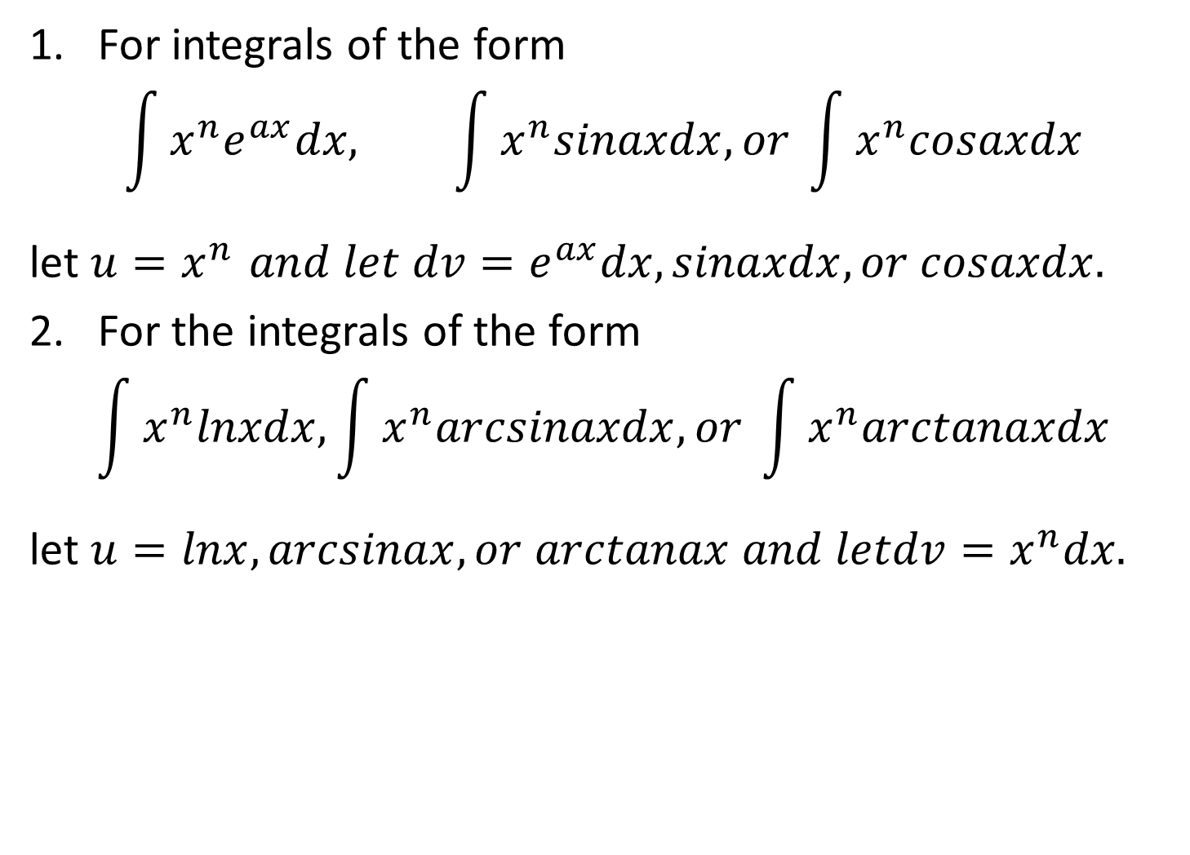
SUMMARY OF COMMON INTEGRALS USING INTEGRATION BY PARTS
For integrals of the form
$$\int{x^{n}e^{ax}dx, \int{x^{n}sinaxdx, or \int{x^{n}cosaxdx}}}$$
let $u=x^{n }and let dv=e^{ax}dx,sinaxdx, or cosaxdx.$
For the integrals of the form
$$\int{x^{n}lnxdx, \int{x^{n}arcsinaxdx, or \int{x^{n}arctanaxdx}}}$$
let $u=lnx,arcsinax,or arctanax and letdv=x^{n}dx.$

Slide 6
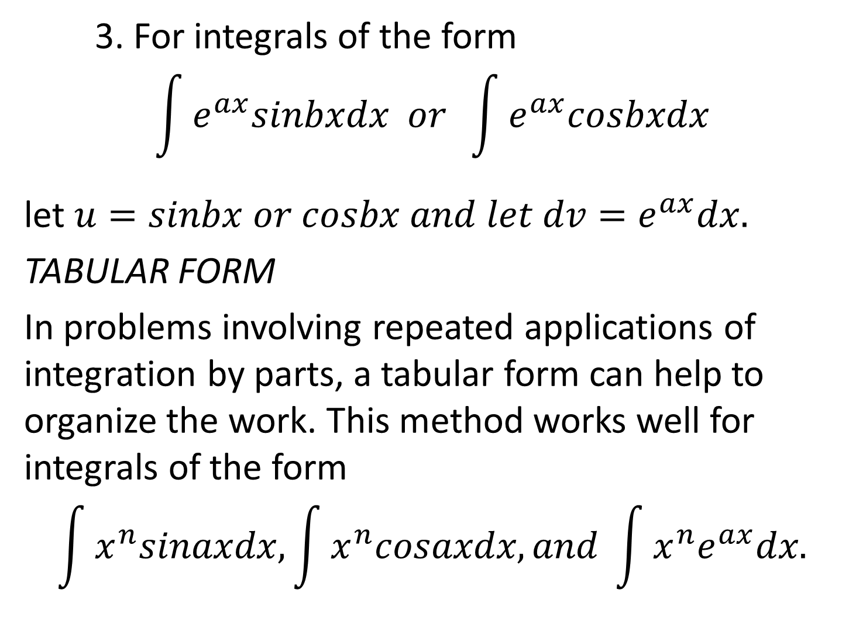
3. For integrals of the form
$$\int{e^{ax}sinbxdx or \int{e^{ax}cosbxdx}}$$
let $u=sinbx or cosbx and let dv=e^{ax}dx.$
TABULAR FORM
In problems involving repeated applications of integration by parts, a tabular form can help to organize the work. This method works well for integrals of the form
$$\int{x^{n}sinaxdx, \int{x^{n}cosaxdx, and \int{x^{n}e^{ax}dx.}}}$$

Slide 7
TABULAR FORM
 | differential | integral
 | 2x | -cosx
 | 2 | -sinx
 | 0 | cosx
+
-
+

Slide 8
TABULAR FORM
 | differential | integral
 | -sinx
 | -cosx
+
-

Slide 9
TABULAR FORM

Slide 10
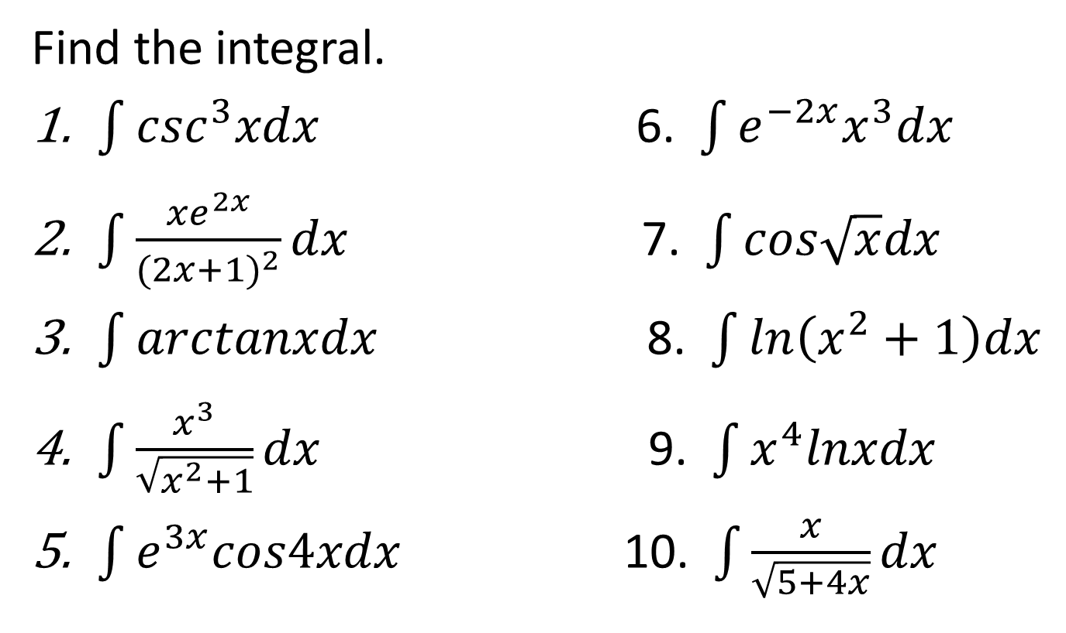
EXAMPLE
Find the integral.
$\int{\csc^{3}xdx}$ 6. $\int{e^{−2x}x^{3}dx}$
$\int{\frac{xe^{2x}}{{(2x+1)}^{2}}dx}$ 7. $\int{cos\sqrt{x}dx}$
$\int{arctanxdx}$ 8. $\int{ln\left(x^{2}+1\right)dx}$
$\int{\frac{x^{3}}{\sqrt{x^{2}+1}}dx}$ 9. $\int{x^{4}lnxdx}$
$\int{e^{3x}cos4xdx}$ 10. $\int{\frac{x}{\sqrt{5+4x}}dx}$

Slide 11
TRIGONOMETRIC SUBSTITUTION
A change of variable in which a trigonometric function is substituted for the variable of integration is called a trigonometric substitution. In many cases, this type of substitution is used, like algebraic substitution to rationalize certain irrational integrands. However, It can also be used in some cases to simplify the integrand even if no radicals are present.

Slide 12
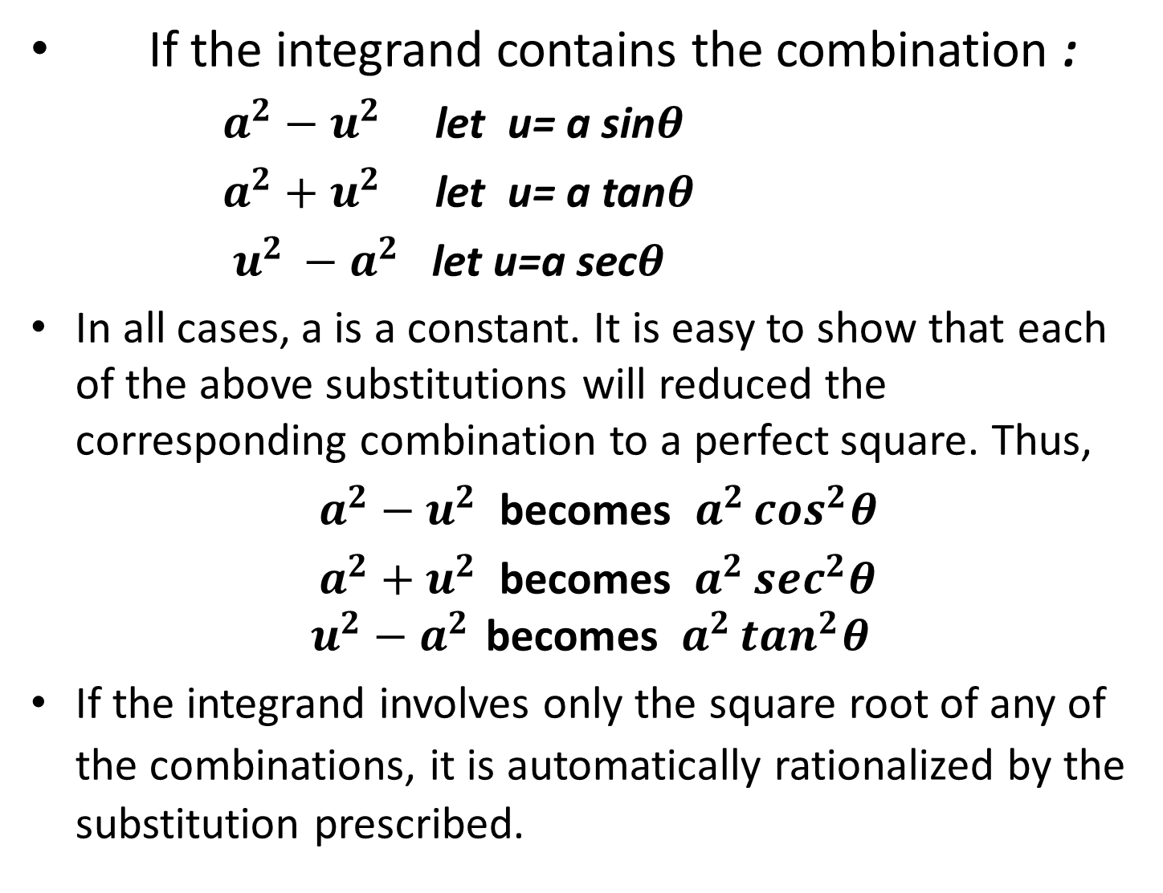
If the integrand contains the combination :
$a^{2}−u^{2}$ let u= a sin$θ$
$a^{2}+u^{2}$ let u= a tan$θ$
$u^{2 }−a^{2}$ let u=a sec$θ$
In all cases, a is a constant. It is easy to show that each of the above substitutions will reduced the corresponding combination to a perfect square. Thus,
$a^{2}−u^{2}$ becomes $a^{2 }\cos^{2}θ$
$a^{2}+u^{2}$becomes $a^{2 }\sec^{2}θ$
$$u^{2}−a^{2 }\text{becomes} a^{2 }\tan^{2}θ$$
If the integrand involves only the square root of any of the combinations, it is automatically rationalized by thesubstitution prescribed.

Slide 13
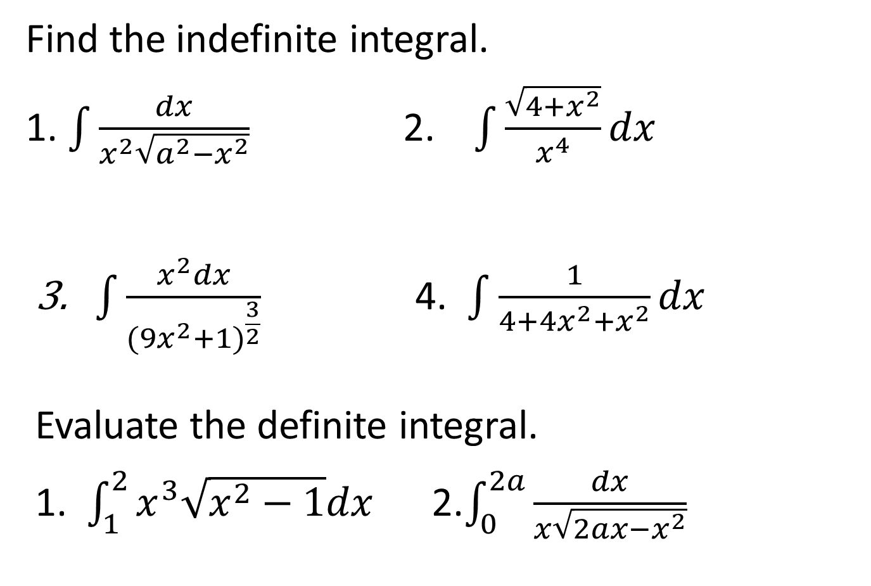
EXAMPLE
Find the indefinite integral.
1. $\int{\frac{dx}{x^{2}\sqrt{a^{2}−x^{2}}}}$2. $\int{\frac{\sqrt{4+x^{2}}}{x^{4}}}dx$
3. $\int{\frac{x^{2}dx}{\begin{aligned}{(9x^{2}+1)}^{\frac{3}{2}} \\ \end{aligned}}}$4. $\int{\frac{1}{4+4x^{2}+x^{2}}dx}$
Evaluate the definite integral.
1. $\int_{1}^{2}{x^{3}\sqrt{x^{2}−1}dx}$ 2.$\int_{0}^{2a}{\frac{dx}{x\sqrt{2ax−x^{2}}}}$

Slide 14
INTEGRATION BY ALGEBRAIC SUSTITUTION
If the substitution involves only algebraic terms, it is called an algebraic substitution. Generally, the purpose of algebraic substitution is to rationalize irrational integrands. Thus, this type of substitution usually involves replacement of radical expression by a new variable.
If a definite integral is to be evaluated by using a substitution, it is usually preferable to change the limits so as to correspond with the change in variable. In this manner, there will be no need to return to the original variable of integration.

Slide 15
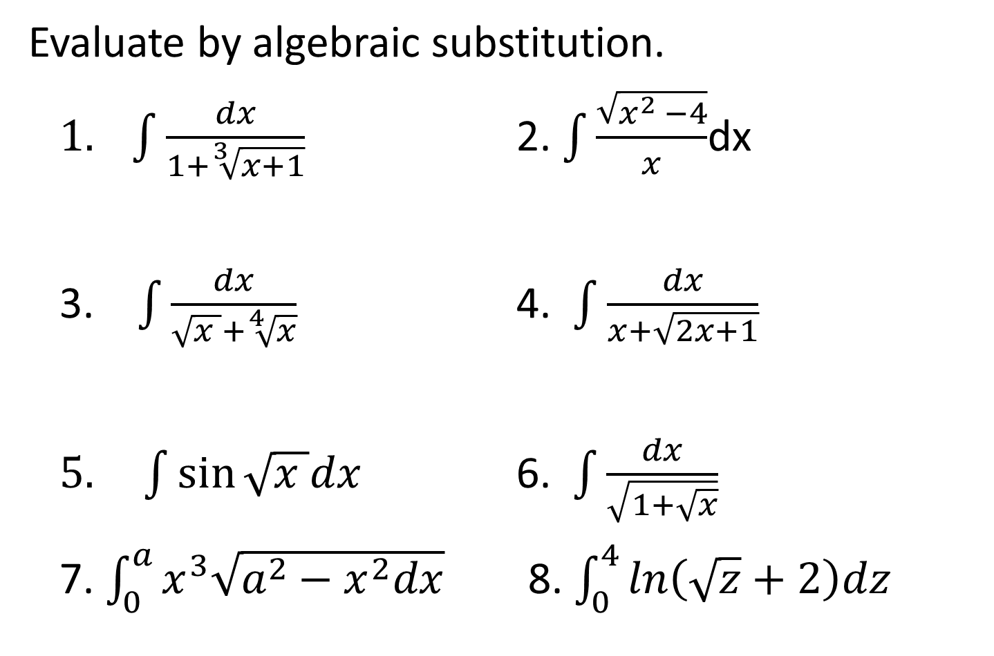
EXAMPLE
Evaluate by algebraic substitution.
$1. \int{\frac{dx}{1+\sqrt[3]{x+1}}}$ 2.$\int{\frac{\sqrt{x^{2 }−4}}{x}}$dx
3. $\int{\frac{dx}{\sqrt{x }+\sqrt[4]{x}}}$4. $\int{\frac{dx}{x+\sqrt{2x+1}}}$
$5. \int{\sin{\sqrt{x }dx}}$ 6.$\int{\frac{dx}{\sqrt{1+\sqrt{x}}}}$
7. $\int_{0}^{a}{x^{3}\sqrt{a^{2}−x^{2}dx}}$ 8. $\int_{0}^{4}{ln\left(\sqrt{z}+2\right)dz}$

Slide 16
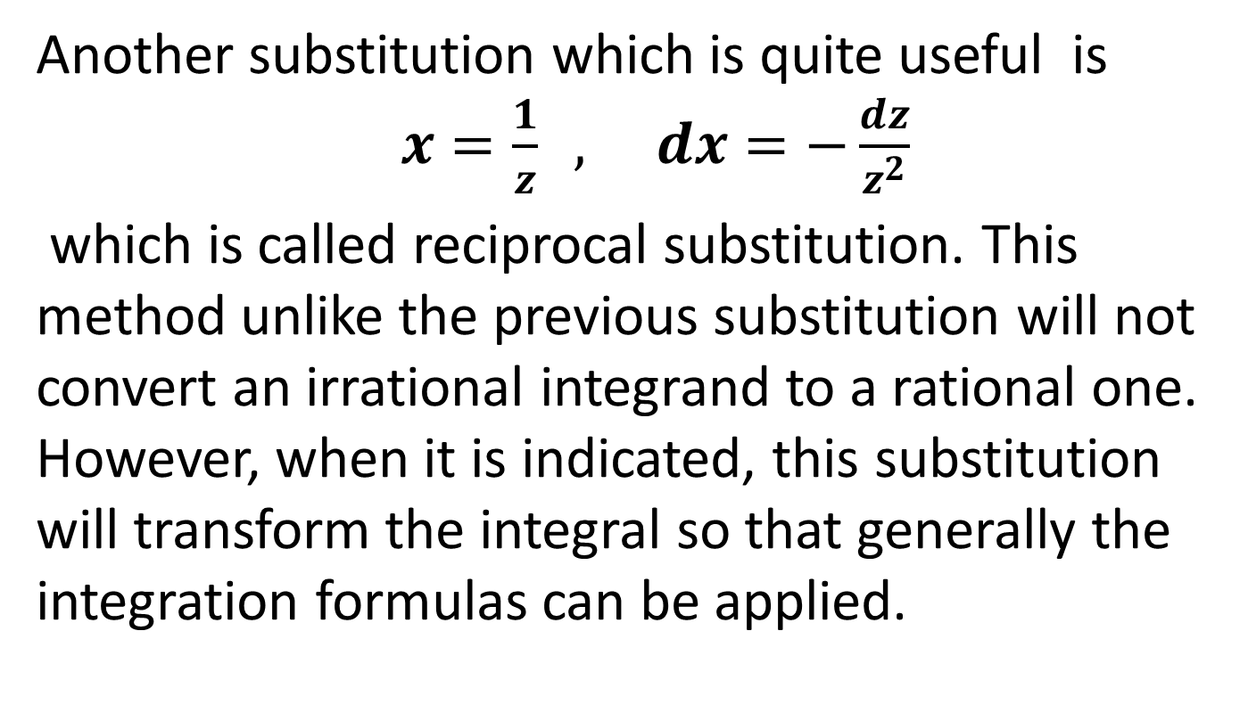
RECIPROCAL SUBSTITUTION
Another substitution which is quite useful is$x=\frac{1}{z} , dx=−\frac{dz}{z^{2}}$
which is called reciprocal substitution. This method unlike the previous substitution will not convert an irrational integrand to a rational one. However, when it is indicated, this substitution will transform the integral so that generally the integration formulas can be applied.

Slide 17
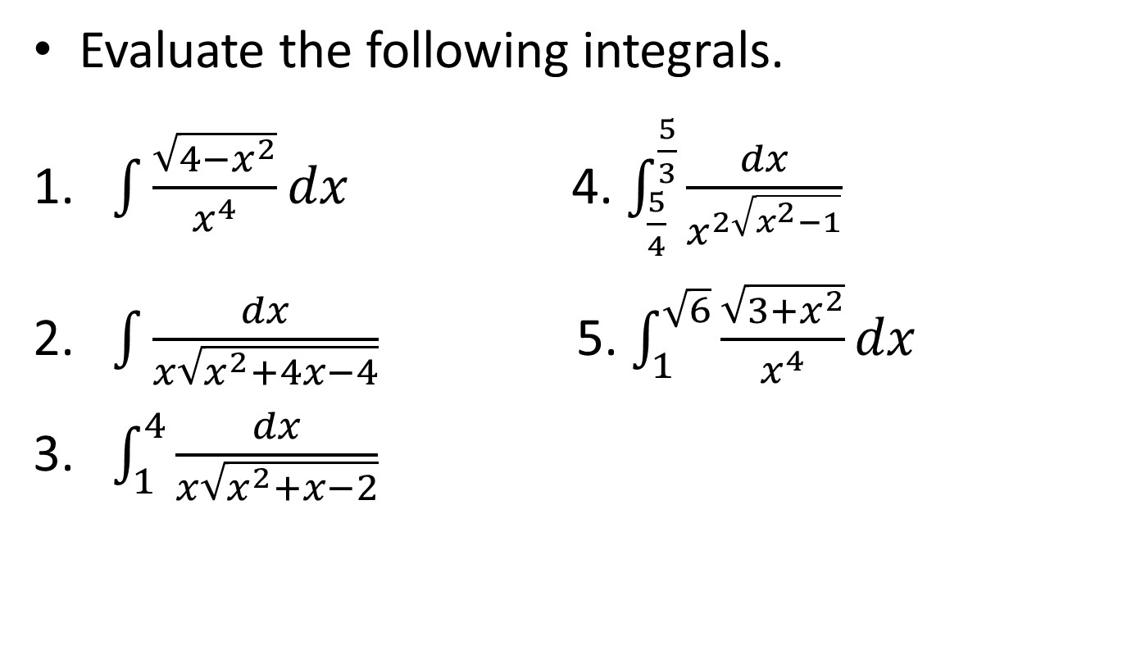
EXAMPLE
Evaluate the following integrals.
1. $\int{\frac{\sqrt{4−x^{2}}}{x^{4}}dx}$4. $\int_{\frac{5}{4}}^{\frac{5}{3}}{\frac{dx}{x^{2\sqrt{x^{2}−1}}}}$
2. $\int{\frac{dx}{x\sqrt{x^{2}+4x−4}}}$5. $\int_{1}^{\sqrt{6}}{\frac{\sqrt{3+x^{2}}}{x^{4}}}dx$
3. $\int_{1}^{4}{\frac{dx}{x\sqrt{x^{2}+x−2}}}$

Slide 18
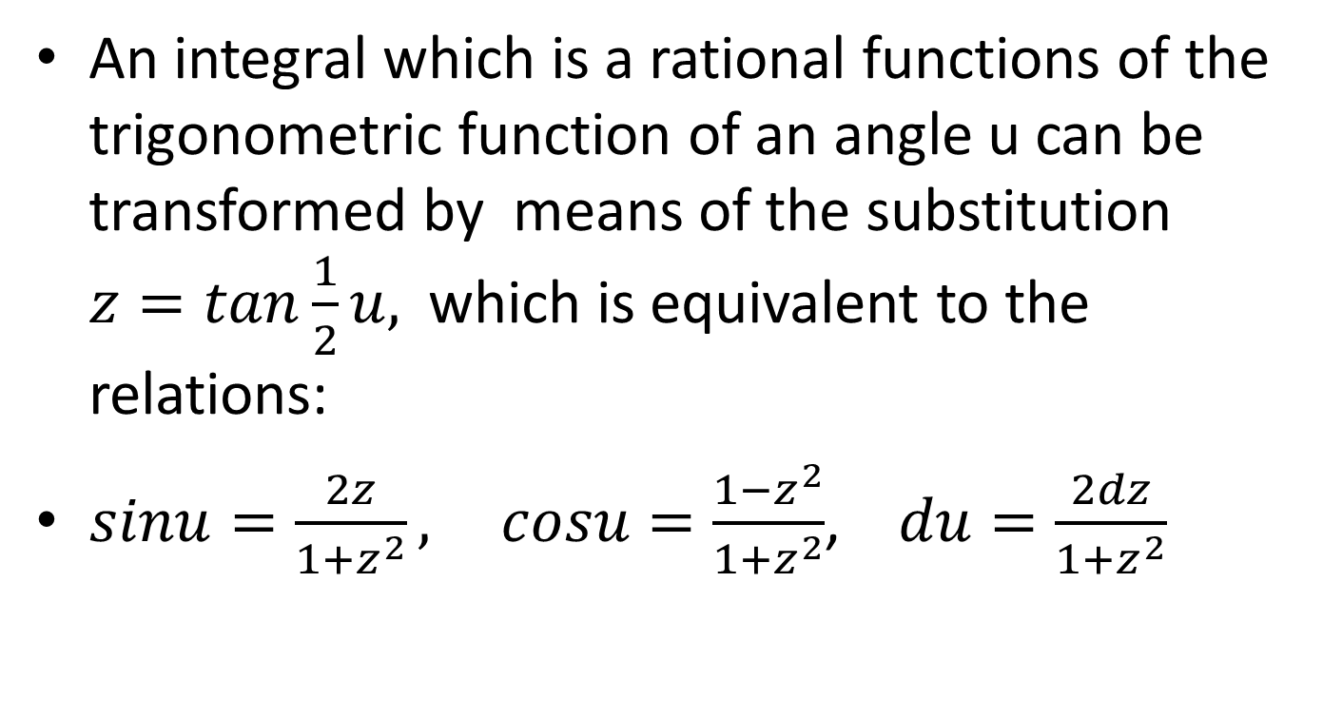
HALF ANGLE SUBSTITUTION
An integral which is a rational functions of the trigonometric function of an angle u can be transformed by means of the substitution $z=tan\frac{1}{2}u,$ which is equivalent to the relations:
$sinu=\frac{2z}{1+z^{2}},$$cosu=\frac{1−z^{2}}{1+z^{2}}$, $du=\frac{2dz}{1+z^{2}}$

Slide 19
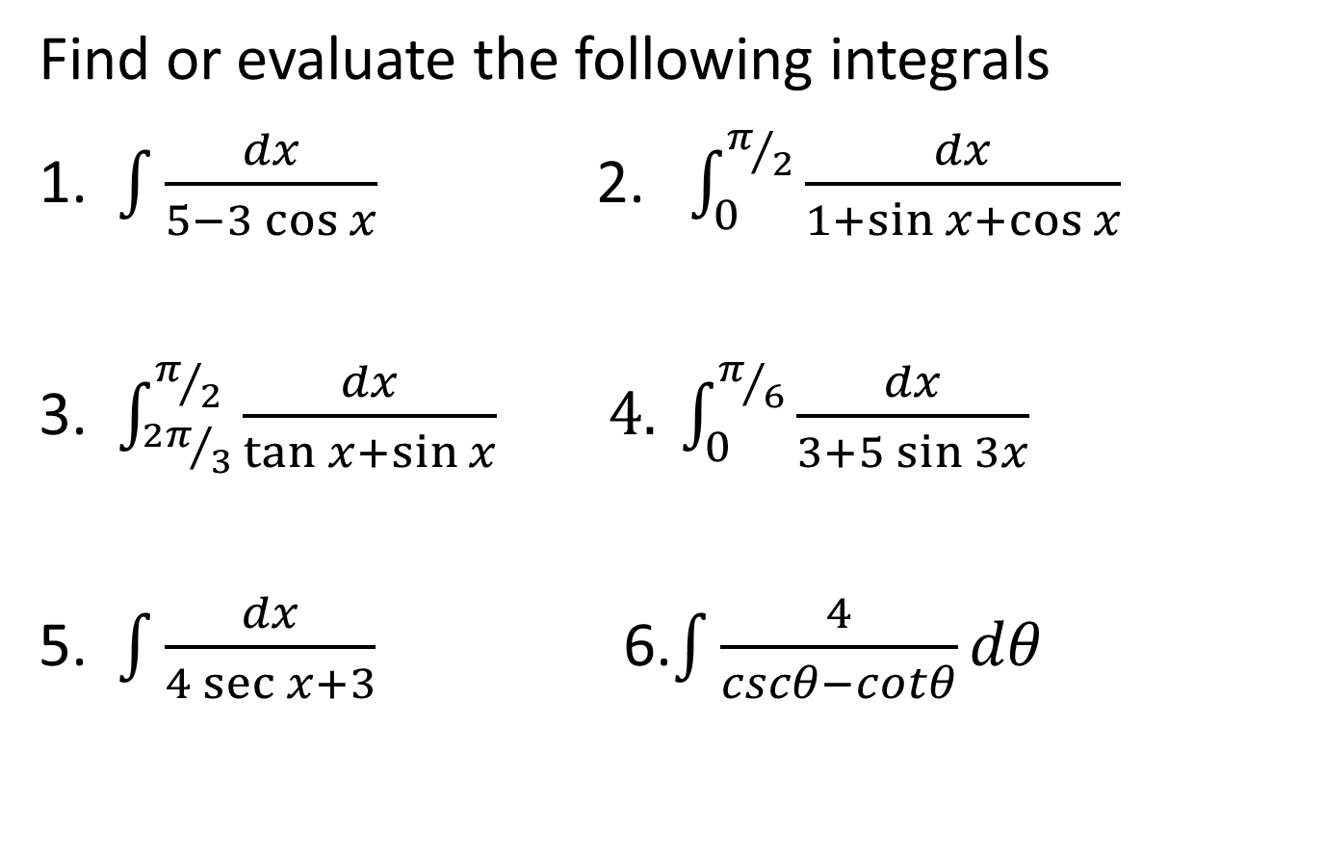
EXAMPLE
Find or evaluate the following integrals
1. $\int{\frac{dx}{5−3\cos{x}}}$ 2. $\int_{0}^{π/2}{\frac{dx}{1+\sin{x+\cos{x}}}}$
3. $\int_{{2π}/3}^{π/2}{\frac{dx}{\tan{x+\sin{x}}}} 4. \int_{0}^{π/6}{\frac{dx}{3+5\sin{3x}}}$
5. $\int{\frac{dx}{4\sec{x+3}}}$ 6.$\int{\frac{4}{cscθ−cotθ}dθ}$

Slide 20
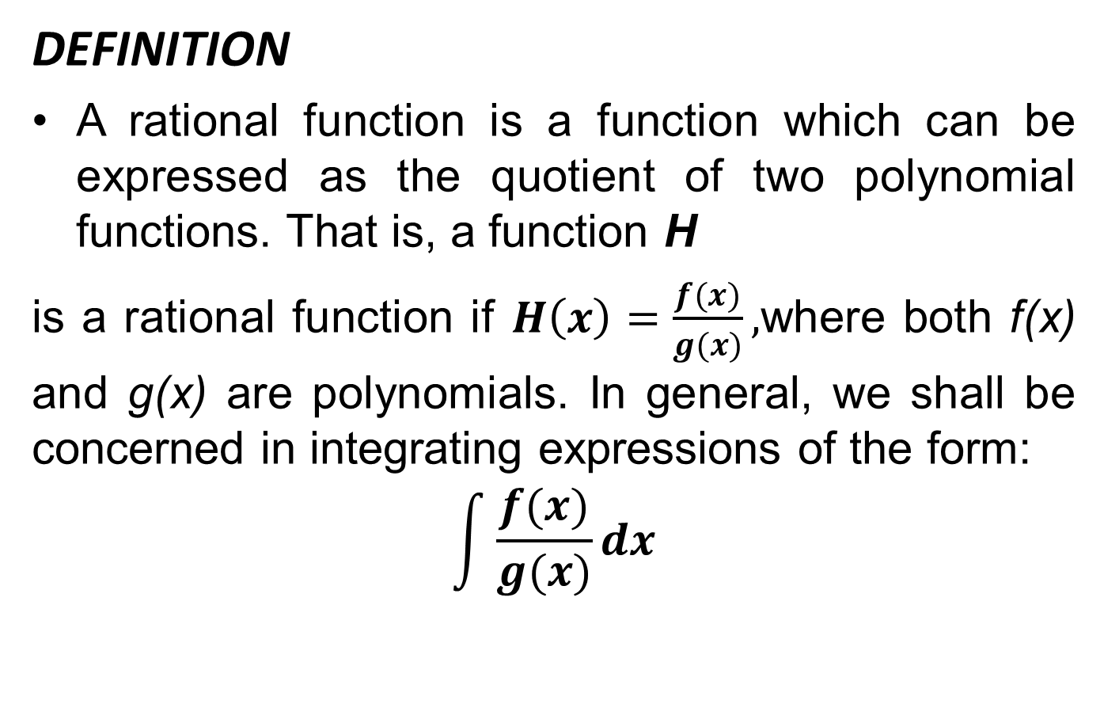
INTEGRATION OF RATIONAL FUNCTION BY PARTIAL FRACTION
DEFINITION
A rational function is a function which can be expressed as the quotient of two polynomial functions. That is, a function H
is a rational function if $H\left(x\right)=\frac{f(x)}{g(x)},$where both f(x) and g(x)are polynomials. In general, we shall be concerned in integrating expressions of the form:
$$\int{\frac{f(x)}{g(x)}dx}$$

Slide 21
The method of partial fractions is an algebraic procedure of expressing a given rational function as a sum of simpler fractions which is called the partial fraction decomposition of the original rational function. The rational function must be in its proper fraction form to use the partial fraction method.

Slide 22
Four cases shall be considered..
Case 1. Distinct linear factor in the denominator.
Case 2. Repeated linear factor in the denominator.
Case 3. Distinct quadratic factor in the denominator.
Case 4. Repeated quadratic factor in the denominator.

Slide 23
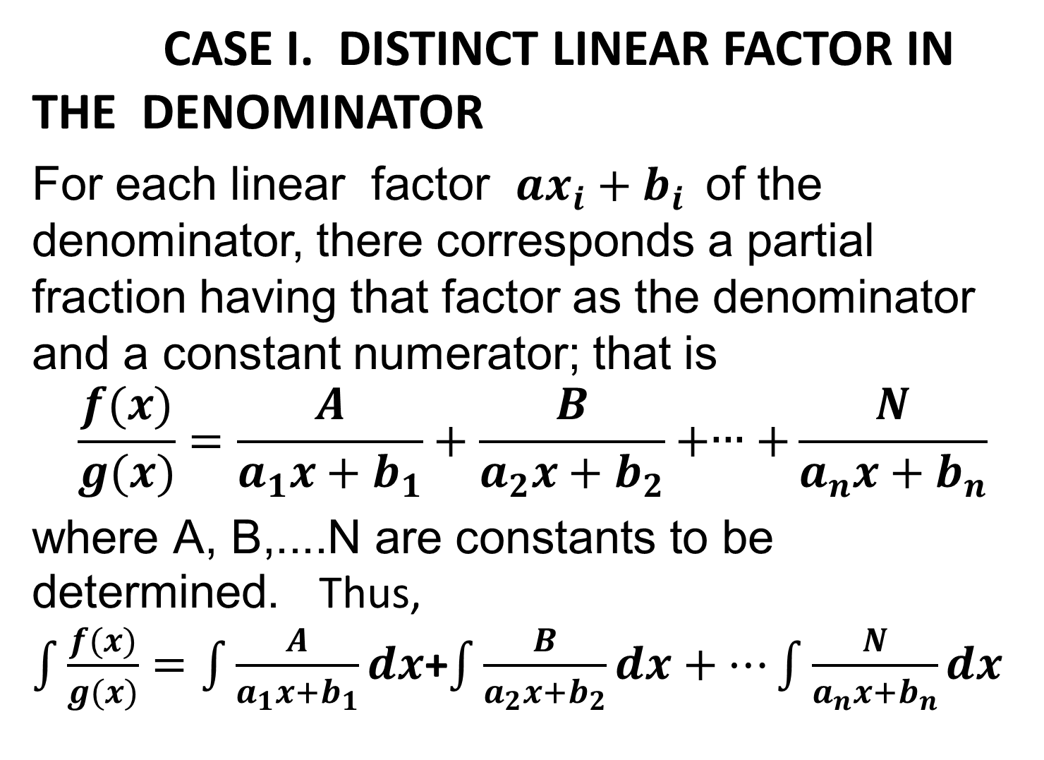
CASE I. DISTINCT LINEAR FACTOR IN THE DENOMINATOR
For each linear factor $ax_{i}+b_{i}$of the denominator, there corresponds a partial fraction having that factor as the denominator and a constant numerator; that is
$$\frac{f(x)}{g(x)}=\frac{A}{a_{1}x+b_{1}}+\frac{B}{a_{2}x+b_{2}}+∙∙∙+\frac{N}{a_{n}x+b_{n}}$$
$\text{where} \text{A}\text{, }\text{B}\text{,....}\text{N} \text{are} \text{constants} \text{to} \text{be} \text{determined}$.Thus, $\int{\frac{f(x)}{g(x)}=\int{\frac{A}{a_{1}x+b_{1}}dx}}$+$\int{\frac{B}{a_{2}x+b_{2}}dx+…\int{\frac{N}{a_{n}x+b_{n}}dx}}$

Slide 24
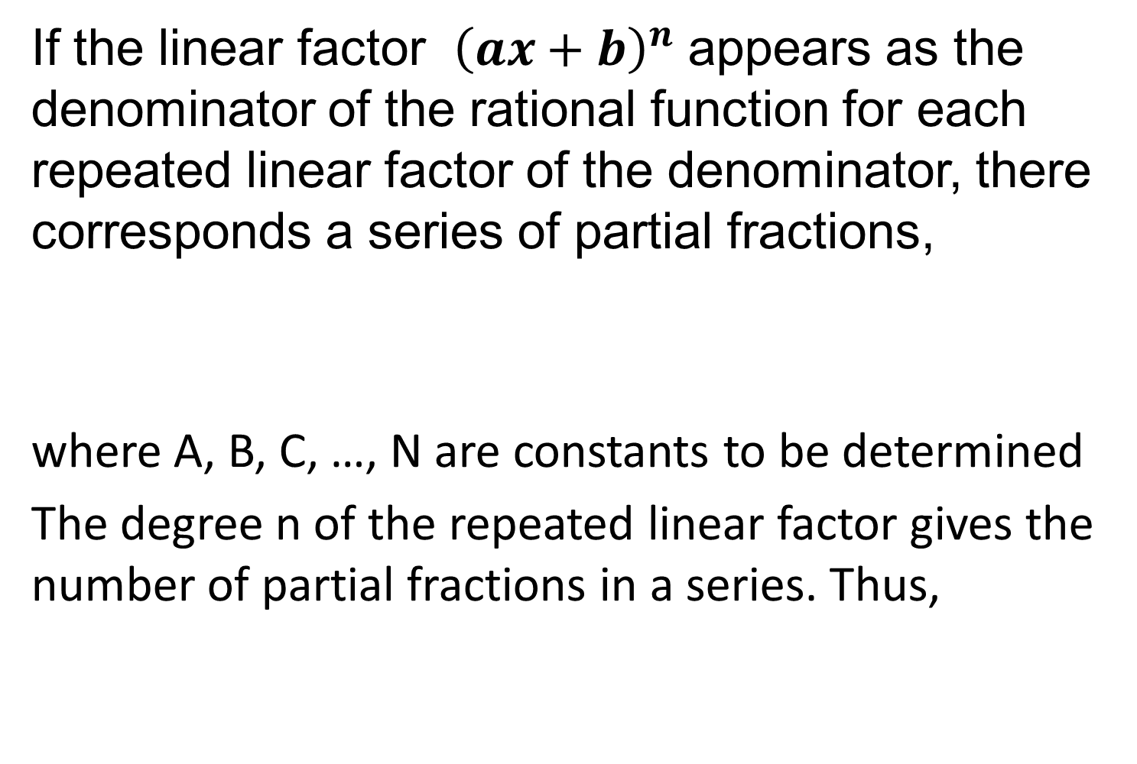
CASE II: REPEATED LINEAR FACTORS
If the linear factor ${\left(ax+b\right)}^{n}$appears as the denominator of the rational function for each repeated linear factor of the denominator, there corresponds a series of partial fractions,
where A, B, C, …, N are constants to be determined
The degree n of the repeated linear factor gives the number of partial fractions in a series. Thus,

Slide 25
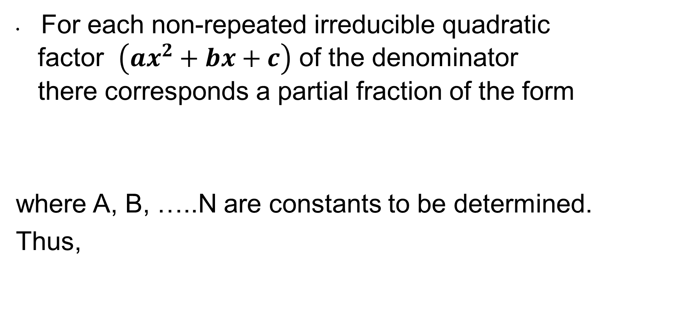
CASE III: QUADRATIC FACTORS
For each non-repeated irreducible quadratic factor $\left({ax}^{2}+bx+c\right)$of the denominator there corresponds a partial fraction of the form
where A, B, …..N are constants to be determined.
Thus,

Slide 26
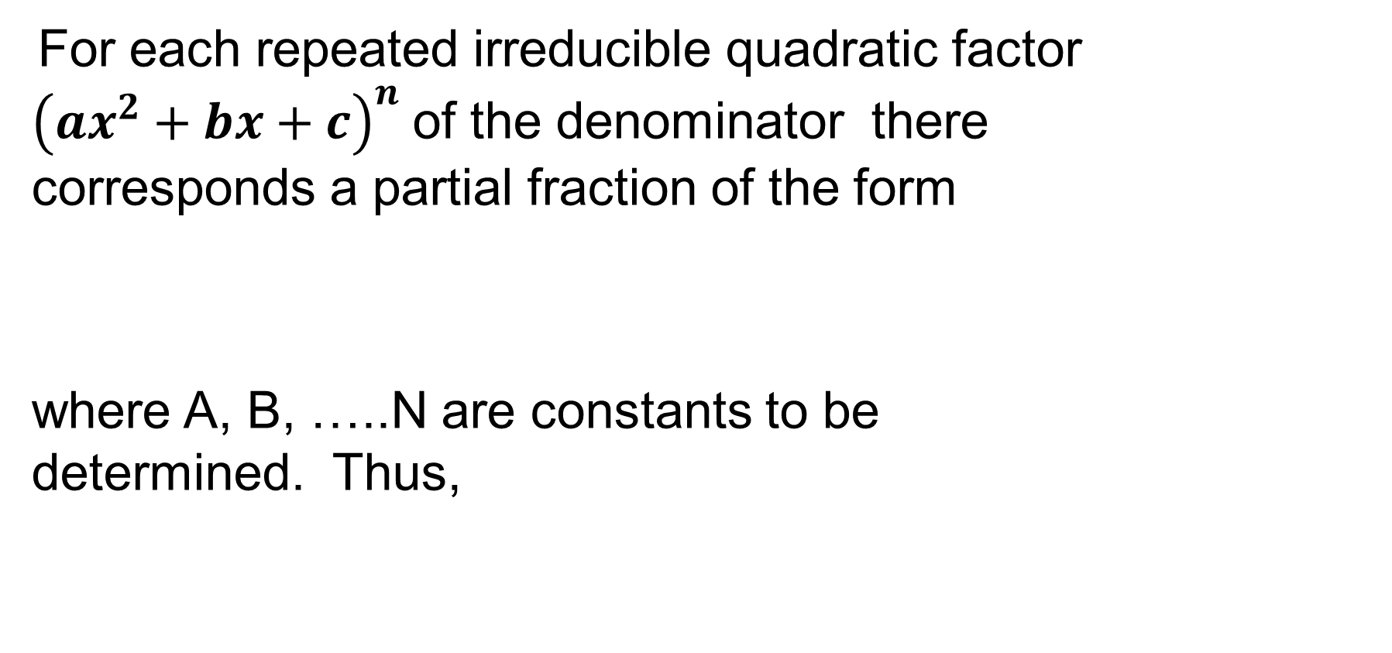
CASE IV: REPEATED QUADRATIC FACTORS
For each repeated irreducible quadratic factor ${\left({ax}^{2}+bx+c\right)}^{n}$of the denominator there corresponds a partial fraction of the form
where A, B, …..N are constants to be determined. Thus,

Slide 27
GUIDELINES FOR SOLVING THE BASIC EQUATION
LINEAR FACTORS
Substitute the roots of the distinct linear
factors in the basic equation.
For repeated linear factors, use the coefficients determined in guideline 1 to rewrite the basic equation. Then substitute other convenient values of x and solve for the remaining coefficients.

Slide 28
QUADRATIC FACTORS
Expand the basic equation
Collect terms according to power of x.
Equate the coefficients of like powers to obtain a system of linear equations involving A, B, C, and so on.
Solve the system of linear equations.

Slide 29
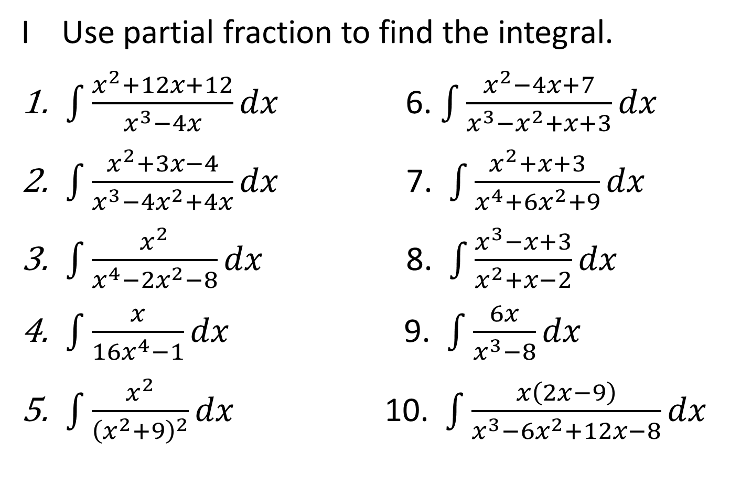
EXAMPLE
I Use partial fraction to find the integral.
$\int{\frac{x^{2}+12x+12}{x^{3}−4x}dx}$ 6. $\int{\frac{x^{2}−4x+7}{x^{3}−x^{2}+x+3}dx}$
$\int{\frac{x^{2}+3x−4}{x^{3}−4x^{2}+4x}dx}$ 7. $\int{\frac{x^{2}+x+3}{x^{4}+6x^{2}+9}dx}$
$\int{\frac{x^{2}}{x^{4}−2x^{2}−8}dx}$ 8. $\int{\frac{x^{3}−x+3}{x^{2}+x−2}dx}$
$\int{\frac{x}{16x^{4}−1}dx}$ 9. $\int{\frac{6x}{x^{3}−8}dx}$
$\int{\frac{x^{2}}{{\left(x^{2}+9\right)}^{2}}dx}$ 10. $\int{\frac{x\left(2x−9\right)}{x^{3}−6x^{2}+12x−8}dx}$

Slide 30
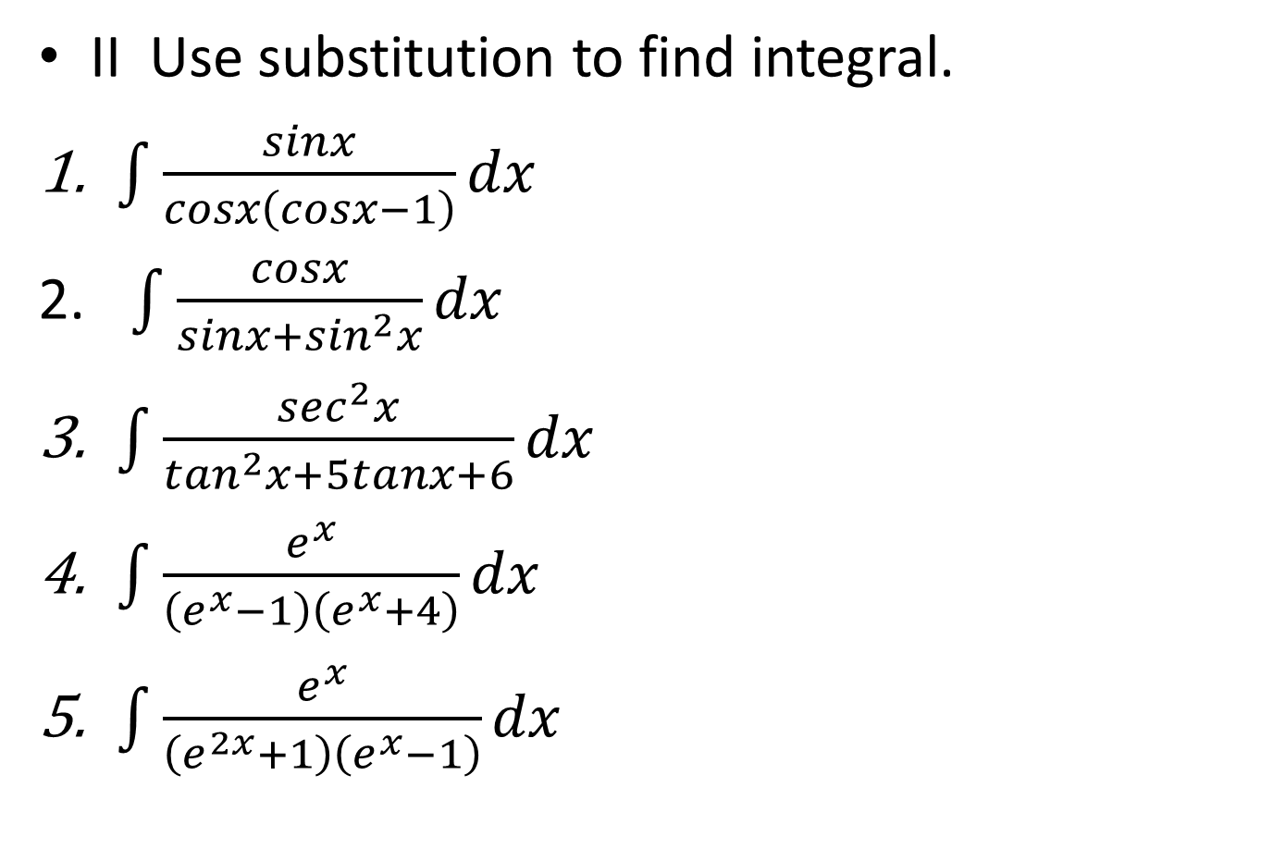
II Use substitution to find integral.
$\int{\frac{sinx}{cosx\left(cosx−1\right)}dx}$
$\int{\frac{cosx}{sinx+\sin^{2}x}dx}$
$\int{\frac{\sec^{2}x}{\tan^{2}x+5tanx+6}dx}$
$\int{\frac{e^{x}}{\left(e^{x}−1\right)\left(e^{x}+4\right)}dx}$
$\int{\frac{e^{x}}{\left(e^{2x}+1\right)\left(e^{x}−1\right)}dx}$

